Slide 1
Introduction to Distributed Algorithm
Part One: Protocols
Chapter 5- Deadlock-free Packet Switching
Teacher: Chun-Yuan Lin
115/11/08
Deadlock-free Packet Switching

Slide 2
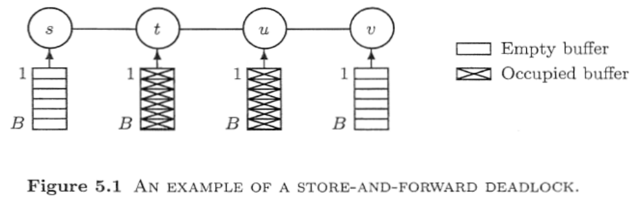
Deadlock-free Packet Switching(1)
Messages (packets) traveling through a packet-switched communication network must be stored at each node before being forwarded to the next node on the path to their destination.
An important problem in the design of packet-switching networks is how to deal with store-and-forward deadlocks.
115/11/08
Deadlock-free Packet Switching

Slide 3
Deadlock-free Packet Switching(2)
An important problem in the design of packet-switching networks is how to deal with store-and-forward deadlocks.
In this chapter we shall treat several methods, referred to as controllers, that can be used to avoid the possibility of store-and-forward deadlocks by introducing restrictions on when a packet can be generated or forwarded.
Methods of avoiding store-and­forward deadlocks are found in the network layer of the OSI reference model.
115/11/08
Deadlock-free Packet Switching

Slide 4
Deadlock-free Packet Switching(3)
Two kinds of method will be discussed, based on structured and unstructured buffer pools.
  Methods using structured buffer pools (Section 5.2) will identify for a node and a packet a specific buffer that must be taken if a packet is generated or received.
  In methods using unstructured buffer pools (Section 5.3) all buffers are equal; the method only prescribes whether or not a packet can be accepted, but does not determine in which buffer it must be placed.
  Some notations and definitions are introduced in Section 5.1.
  We conclude the chapter with a discussion of further issues in Section 5.4.
115/11/08
Deadlock-free Packet Switching

Slide 5
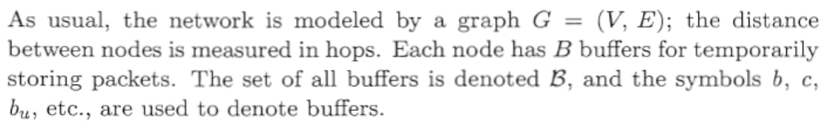
Introduction(1)
The handling of packets by the nodes is described by the following three types of moves that can occur in the network.
  Generation
    A node u "creates" a new packet p and places it in an empty buffer in u. The node u is called the source of p in this case.
  Forwarding
    A packet p is forwarded from a node u to an empty buffer in the next node w on its route. As a result of the move the buffer previously occupied by p becomes empty.
115/11/08
Deadlock-free Packet Switching

Slide 6
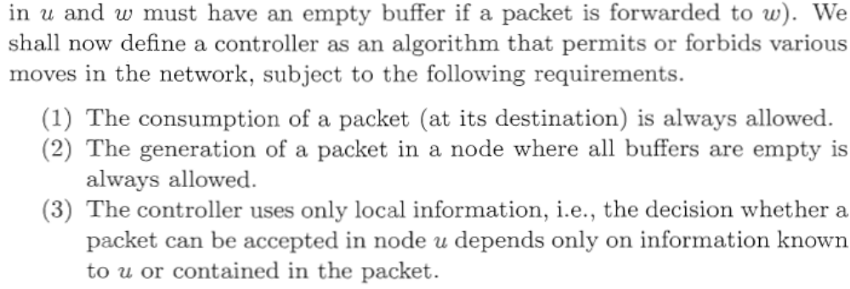
Introduction(2)
  Consumption
    A packet p occupying a buffer in its destination node is removed from the buffer.
115/11/08
Deadlock-free Packet Switching

Slide 7
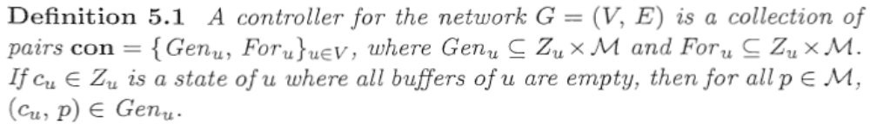
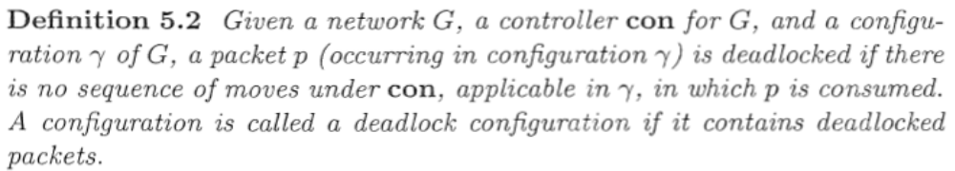
Introduction(3)
115/11/08
Deadlock-free Packet Switching

Slide 8
Structured Solutions
We shall now discuss a class of controllers relying on so-called buffer graphs, introduced by Merlin and Schweitzer.
The principle of these buffer graphs is based on the observation that a deadlock is due to a cyclic wait situation.
Cyclic waits are avoided by moving the packets along paths in an acyclic graph (the buffer graph). (no simple cycle)
115/11/08
Deadlock-free Packet Switching

Slide 9
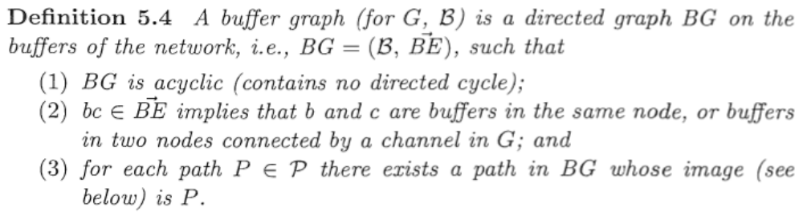
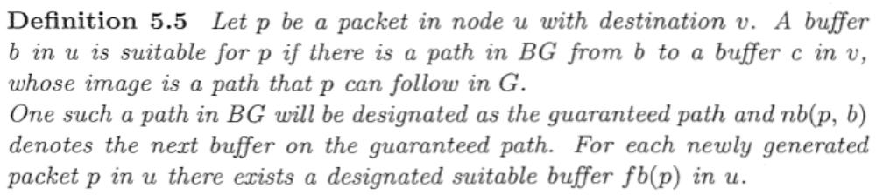
Buffer Graphs (1)
115/11/08
Deadlock-free Packet Switching

Slide 10
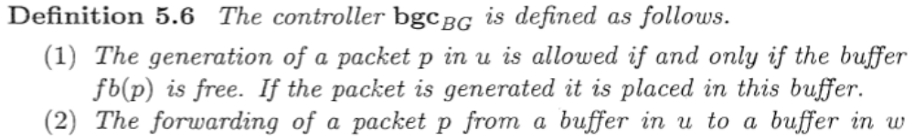
Buffer Graphs (2)
The buffer-graph controller. A buffer graph BG can be used to implement a deadlock-free controller bgc_{BG} provided that the buffer nb(p, b) is encoded in each packet and/or the state of the node where presides.
115/11/08
Deadlock-free Packet Switching

Slide 11
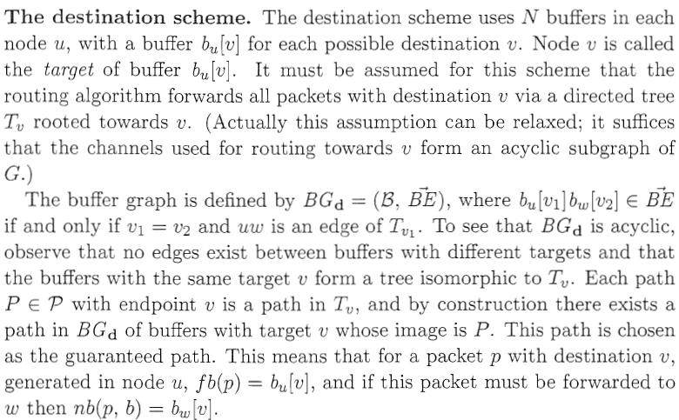
Buffer Graphs (3)
Two examples of the use of buffer graphs, namely the destination scheme and the hops-so-far scheme.
For a specific destination d
115/11/08
Deadlock-free Packet Switching

Slide 12
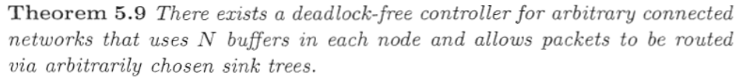
Buffer Graphs (4)
The controller dest is very simple to use, but has the disadvantage that a large number of buffers is required in each node, namely N.
115/11/08
Deadlock-free Packet Switching

Slide 13
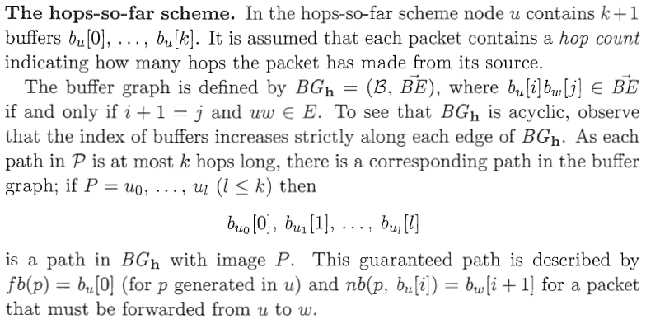
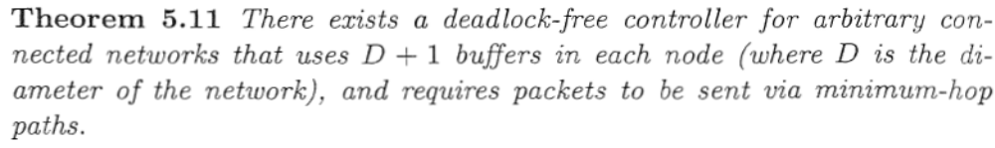
Buffer Graphs (5)
diameter
115/11/08
Deadlock-free Packet Switching

Slide 14
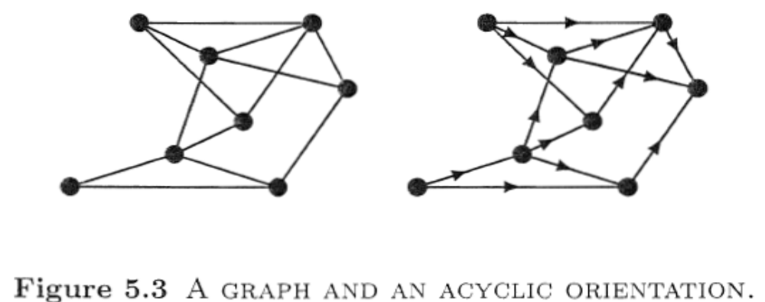
Orientations of G (1)
In the hops-so­far controller the index of the buffer in which a packet is stored increases with every hop.
We shall now allow a slower growth of the buffer index by assuming an increase in the buffer index with certain, but not necessarily all, hops.
115/11/08
Deadlock-free Packet Switching

Slide 15
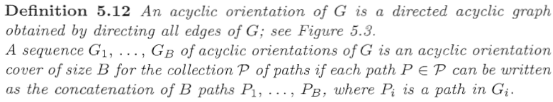
Orientations of G (2)
We refer to the resulting class of controllers as acyclic orientation cover controllers, or AOC controllers, for short.
115/11/08
Deadlock-free Packet Switching

Slide 16
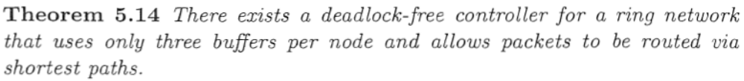
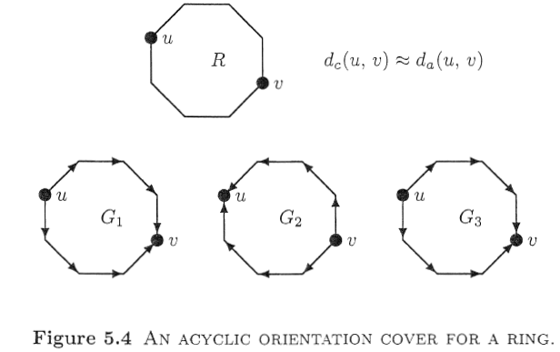
Orientations of G (3)
Packet switching on a ring. Acyclic orientation covers can be used to give deadlock-free controllers for several classes of networks.
115/11/08
Deadlock-free Packet Switching

Slide 17
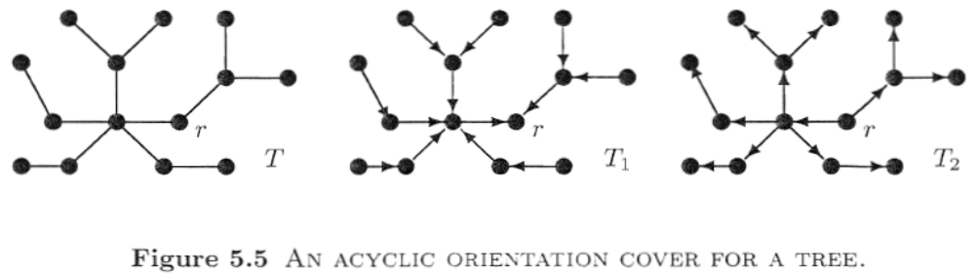
Orientations of G (4)
Packet switching on a tree. Acyclic orientation covers can be used to construct a controller using only two buffers per node for a network that is a tree.
115/11/08
Deadlock-free Packet Switching

Slide 18
Unstructured Solutions
We shall now discuss a class of controllers proposed by Toueg and Ullman. These controllers do not prescribe in which buffer a packet must be placed, and they use only simple local information such as the hop count or the number of occupied buffers in a node.
115/11/08
Deadlock-free Packet Switching

Slide 19
Forward-count Controllers
115/11/08
Deadlock-free Packet Switching

Slide 20
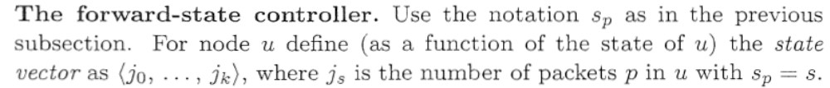
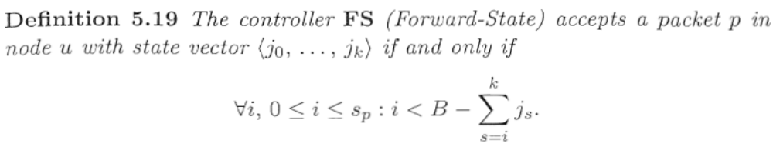
Forward-state Controllers
115/11/08
Deadlock-free Packet Switching

Slide 21
Backward-count Controllers
115/11/08
Deadlock-free Packet Switching

Slide 22
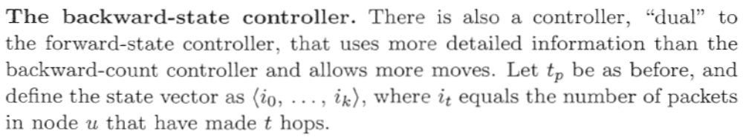
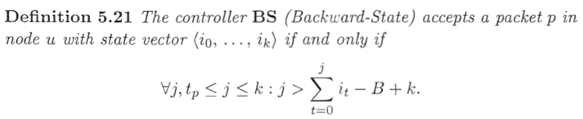
Backward-state Controllers
115/11/08
Deadlock-free Packet Switching

Slide 23
Further Issues (1)
In the results of this chapter the number of buffers needed by a controller has always played a role. It is usually the case that the throughput is increased if more buffers are available.
  In the unstructured solutions only a lower bound on the number of buffers is given; a larger number can be used without any modification.
  In the structured solutions additional buffers must somehow be inserted into the buffer graph, which call be done either statically or dynamically.
115/11/08
Deadlock-free Packet Switching

Slide 24
Further Issues (2)
Topological Changes
  After the occurrence of such a change the routing tables of each node will be updated and the packet is then forwarded using the changed values of these tables.
  The controller dest.
  Hop-counting controllers.
115/11/08
Deadlock-free Packet Switching

Slide 25
Further Issues (3)
Other Types of Deadlock
  Only store-and-forward deadlocks have been considered in this chapter.
  Merlin and Schweitzer consider four types,
    Progeny deadlock may arise when a packet p in the network can create another packet q,
    Copy-release deadlock may arise when the source holds a copy of the packet until an acknowledgement for the packet is received from the destination.
    Pacing deadlock may arise when the network contains nodes, with limited internal storage, that may refuse to consume messages until some other messages have been generated.
115/11/08
Deadlock-free Packet Switching

Slide 26
Further Issues (4)
    Reassembly deadlock may arise in networks where large messages are divided into smaller packets for transmission and no packet can be removed from the network until all packets of the message have reached the destination.
115/11/08
Deadlock-free Packet Switching

Slide 27
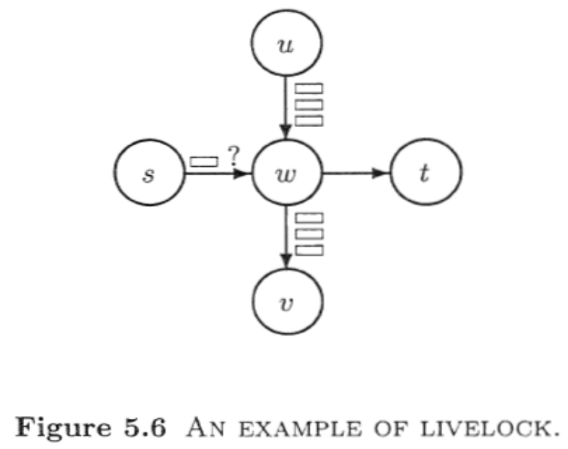
Further Issues (5)
Livelock
  The definition of deadlocked packets implies that under a deadlock-free controller there exists for each packet at least one computation in which the packet is consumed.
115/11/08
Deadlock-free Packet Switching

Slide 28
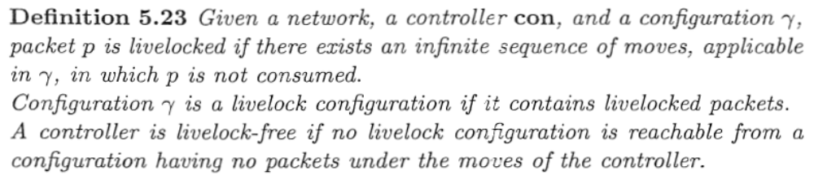
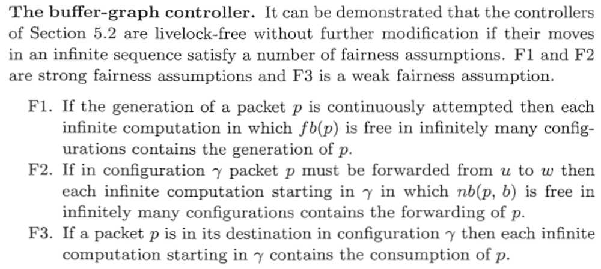
Further Issues (6)
115/11/08
Deadlock-free Packet Switching

Slide 29
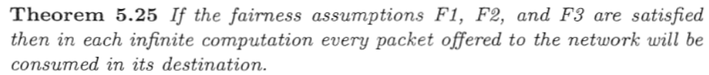
Further Issues (7)
115/11/08
Deadlock-free Packet Switching

